Slide 1

EEE 222 (D2)
Water irrigation system
Presented by-
Group – 3
Afiah (21201193)
Khadija Akter (21201194)
Azlina Arabi Hossain (21201192)
Abdullah Al Redwan (21201195)
Mumtaheena Binte Ahmed (21201198)
Jahidul Islam (21201197)

Slide 2

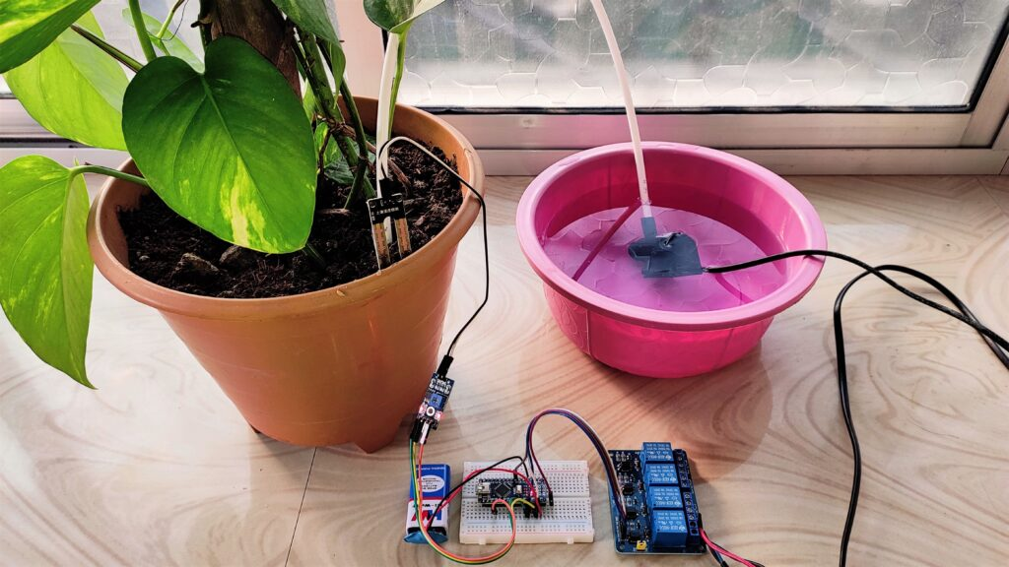
What is Water Irrigation System?
It is an automatic watering system which delivers the right amount of water to the right place at the right time .
This system does the control of soil moisture, doing indications via LEDs and in case of dry soil emitting , a alarm beep. Then it will activate the irrigation system pumping water for watering plants through various systems of tubes, pumps, and sprays.

Slide 3
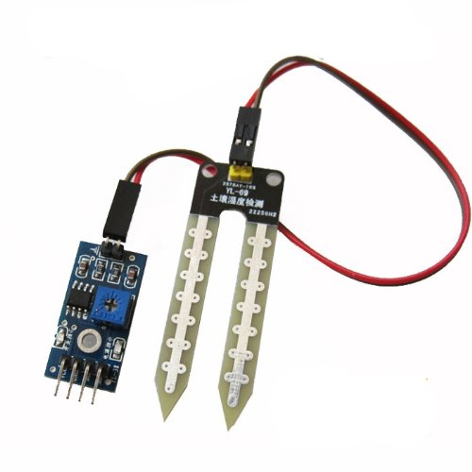
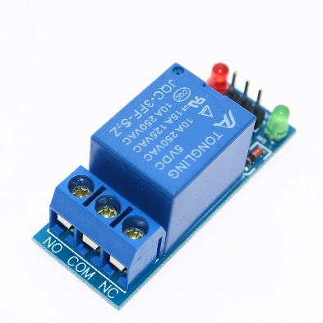
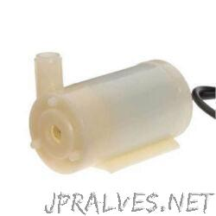
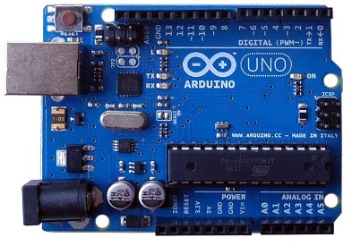
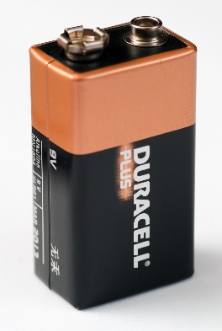
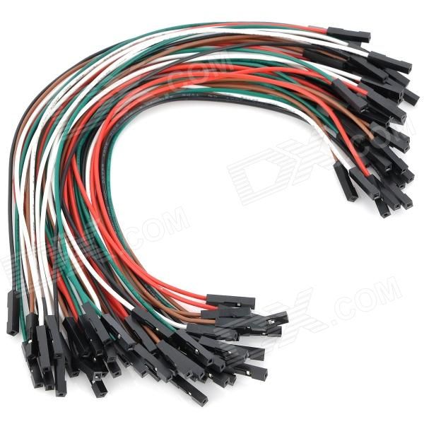
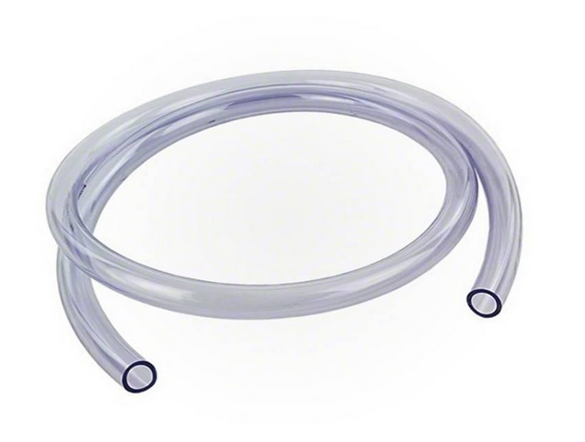
Necessary Parts for the Project
Arduino Uno R3
Moisture Sensor
Relay Module
Mini Water Pump
Battery 9V
Connecting Wires
PVC Tubing Pipe

Slide 4
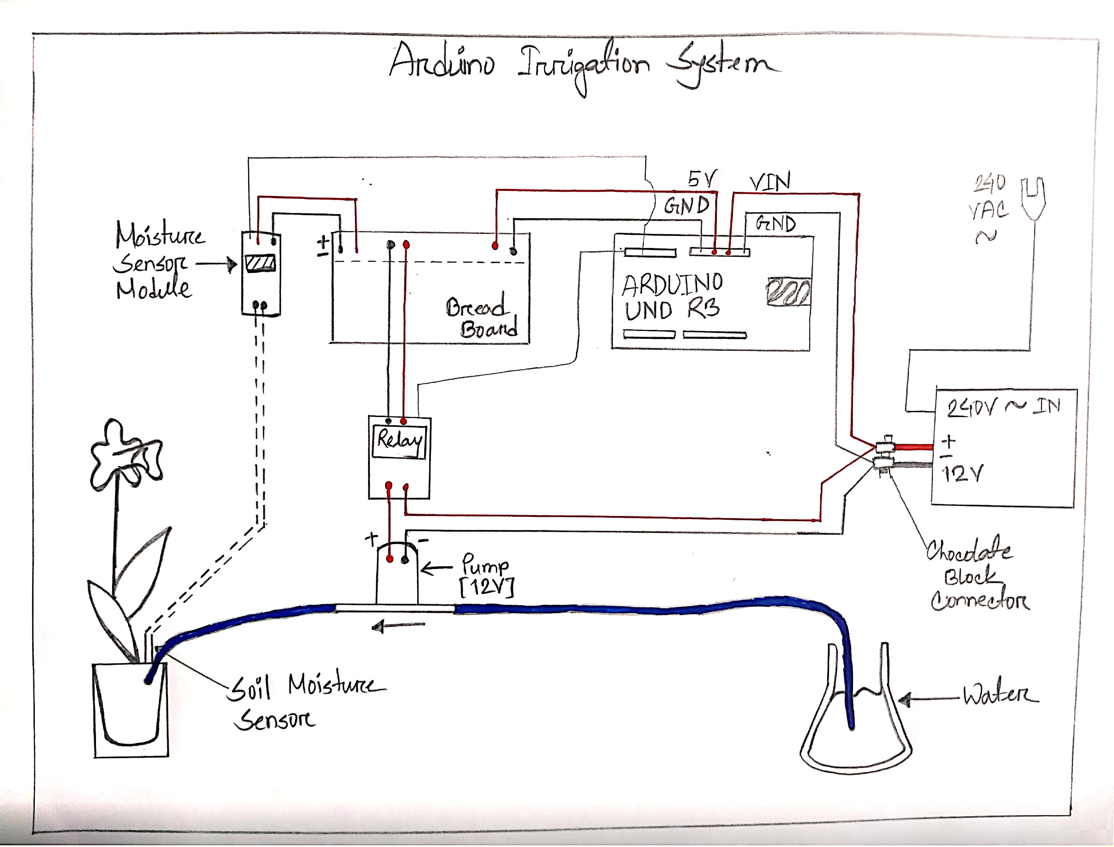
How It Works
Arduino will use the soil moisture sensor to measure the moisture of the soil to determine if the soil is wet or not.
The Arduino board will switch on the relay module if the soil is dry, the water pump will then turn on. The water pump will be on until the soil's moisture level gets to a particular level.

Slide 5
Purpose of this project-
1. Easy-to-use and anyone can make it.
2. The two most significant hazards to the agriculture industry ,are the need for extensive labor and water shortages. The use of automatic plant watering systems eliminates both of these problems.
3. Water plants at specified times and amounts by monitoring the hydration levels in the soil surrounding them.
4. can be used in homemade gardens and also be deployed in fields for large-scale use.
5. It can keep plants watered while one is away on vacation or when one is primarily busy and not at home to look after the plants.
6. Plants won’t die because of less water in the soil.
7. No more wastage of water.

Slide 6


Plant more trees and the world will smile like this!!
Thank you!!

